Slide 1
Operating Systems
Dr. Deepak Dembla

Slide 2
Deadlocks

Slide 3
Objectives
Definition of deadlock
Resource Allocation graph(RAG) based representation of deadlock
Wait-for graph based representation of deadlock
Conditions for occurrence of deadlock
Deadlock Prevention methods
Deadlock avoidance methods
Banker’s algorithm for deadlock avoidance
Deadlock detection methods
Recovery from deadlock
Two-phase locking
Starvation

Slide 4
A situation in the system when a set of concurrent processes in a system request the resources in such a conflicting manner that there is indefinite delay in resource allocation.
Deadlock

Slide 5
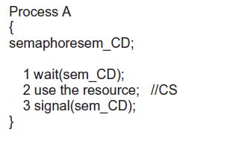
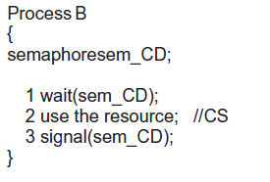
Deadlock using semaphores

Slide 6
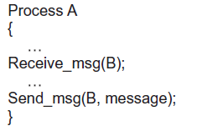
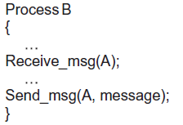
Deadlock using semaphores

Slide 7
Resource allocation graph (RAG)
Processes
Resources
Modeling the deadlock
P
Instances of resource type
R

Slide 8
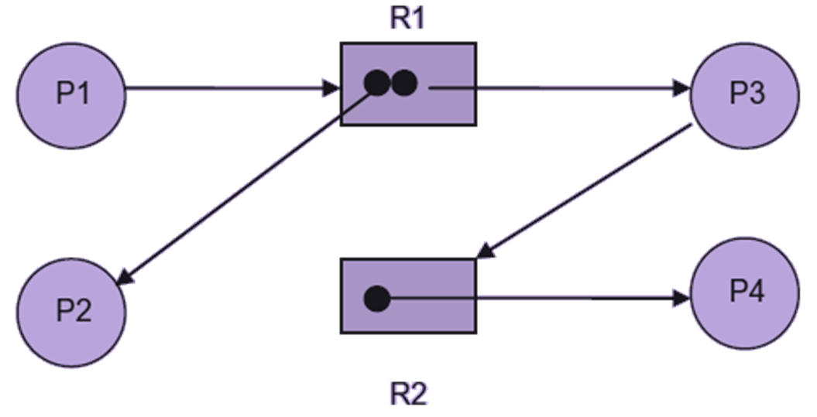
Resource allocation graph (RAG)

Slide 9
Conditions for a deadlock
Mutual Exclusion
Hold and wait
No Preemption
Circular wait

Slide 10
Fact 1: There are four necessary conditions for the occurrence of a deadlock: Mutual exclusion, hold and wait and non-preemption and circular wait.
Fact 2: The circular wait along with other three conditions becomes the necessary conditions for a deadlock but not sufficient condition.
Fact 3: The necessary and sufficient condition for a deadlock is that a cycle must be present in the RAG representation of the system, i.e. a circular wait is there and all the resource types in the system have only single instance.
Conditions for a deadlock

Slide 11
Deadlock prevention
Deadlock avoidance
Deadlock Detection and Recovery
Deadlock handling

Slide 12
Data Structures
Total_Res[i] = j
Max[i,j] = k
Alloc[i,j] = k
Av[i] = j
Av[i] = Total_Res[i] – ∑_{all processes}Alloc[i]
Need[i,j] = k
Need[i,j] = Max[i,j] – Alloc[i,j]
Req_{i}[j] = k
Dijkstra’s Banker’s algorithm for Deadlock avoidance in multiple instances of resources

Slide 13
Let Current_Avail and Marked be two vectors of length n and p respectively. SafeString is an array to store the process IDs.
1. Current_Avail = Av
2. Initialize Marked as: for(i=1; i<=p; i++)
Marked [i] = false;
3. Find a process P_{i} such that
Need_{i} <= Current_Avail and Marked [i] =false
4. if (found)
{
Current_Avail = Current_Avail + Alloc_{i}
Marked [i] = true
Save the process number in Safestring[]
Go to step 3.
}
Safety test algorithm

Slide 14
5. if(Marked [i] == true) for all processes, then the system is in safe state.
Print SafeString. else the system is not in safe state and is in deadlock.
Safety test algorithm

Slide 15
Req_{i} is the vector to store the resource request for process P_{i}. if (Req_{i} > Need_{i} ) the request is not a feasible request and is rejected. else if (Req_{i} > Av)
Resources are not available, so the process must wait.
Resource request handling algorithm

Slide 16
else
{
Assume we allocate the requested resource to the process and update the state as:
Av = Av – Req_{i}
Alloc_{i} = Alloc_{i} + Req_{i}
Need_{i} = Need_{i} – Req_{i}
Execute the Safety Test Algorithm assuming the state has been changed. if (state is safe)
Change the state in actual and resource is allocated to the process. else
Keep the state unchanged and do not allocate the resource to the process.
}
Resource request handling algorithm

Slide 17
Let Current_Avail and Marked be two vectors of length n and p respectively. SafeString is an array to store the process IDs.
1. Current_Avail = Av
2. For all i = 1 to p,
Initialize Marked as Marked [i] = false;
If (Alloc_{i} = 0)
Initialize Marked as Marked [i] = false;
3. Find a process P_{i} such that
Req_{i} <= Current_Avail and Marked [i] =false
Detection algorithm

Slide 18
4. if (found)
{
Current_Avail = Current_Avail + Alloc_{i}
Marked [i] = true
Save the process number in Safestring[]
Go to step 3.
}
5. if(Marked [i] == true) for all processes, then the system is not in deadlocked state.
Print SafeString. else the system is in deadlock caused by Process P_{i}.
Detection algorithm

Slide 19
Recovery from deadlock
Resource Preemption
Rollback
Abort the process

